Slide 1
KV4001 Week 5
Abstract Classes

Slide 2
Employee Case Study
We are going to consider an application designed to keep track of the employees of a company.
There are two types of employee
hourly paid
salaried
The application will maintain lists of all employees and allow for various commands and queries.

Slide 3
Employee Case Study continued
For each employee we will keep:
their name
their staff number
For salaried employees we also need:
their annual salary
For hourly paid we also need to keep:
their wage rate
the number of hours they have worked in a month

Slide 4
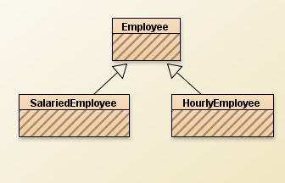
Employee Case Study continued
Having two types of employee suggests that we might consider inheritance
An Employee Class to hold the common attributes and functions
Two specialised classes

Slide 5
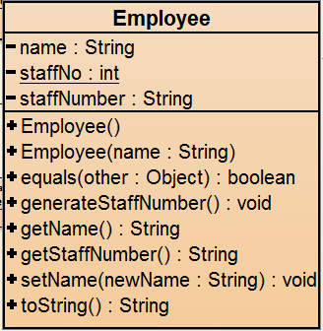
Specification for Employee
Class: Employee
attributes:
name
staffNo //generate a new staff number
staffNumber
accessors:
getName
getStaffNumber
toString
equals
mutators:
setName
generateStaffNumber
//static (class) variable

Slide 6
Employee
public class Employee
{
private String name, staffNumber;
// Allocate staff number by incrementing this variable
private static int staffNo = 10000; // class variable
// Two constructors:
public Employee( )
{
name = "No name";
staffNumber = “Unallocated”;
}
public Employee(String name)
{
this.name = name;
// get the existing staffNo value.
// Increment it and add the new number to staffNumber
staffNumber = “” + (++staffNo);
}

Slide 7
Equals for Employee
public boolean equals(Object other)
{
if ( other == null)
{
return false;
}
if ( !( other instanceof Employee) )
{
return false;
}
if ( this == other)
{
return true;
}
Employee otherEmployee = (Employee)other;
return (name.equals(otherEmployee.name)
&& staffNumber.equals(otherEmployee.staffNumber));
}
See next slide
// equals method of Object class
// equals method of String class

Slide 8
instanceof
The instanceof operator checks to see if an object is of the type given as its second argument
Syntax:
object instanceof className
Returns true if the object is of type className or a subtype - otherwise false.
Will return true if object is of type of a descendent of className

Slide 9
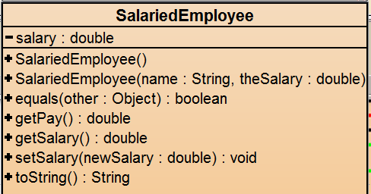
SalariedEmployee
Simple getter / setter methods
getPay returns salary/12
Code on Blackboard

Slide 10
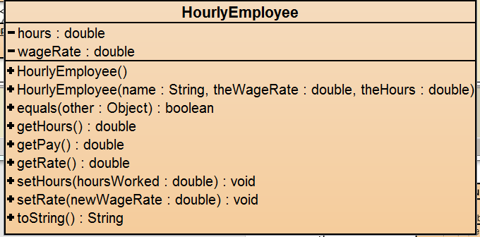
HourlyEmployee
Extends Employee
Extra attributes:
Hours worked in month
Hourly wage rate
getPay returns monthly pay
Code on Blackboard

Slide 11
Exercise 1
Create a project and from Blackboard add the classes:
Employee
SalariedEmployee
HourlyEmployee
Compile and make sure the program works by instantiating an instance of each object and checking out the key behaviour.

Slide 12
A Question
When would we want to create an Employee object?
The answer is:

Slide 13
Abstract Classes
An abstract class in Java is a class that is never instantiated.
Its purpose is to be a parent to several related classes.
The child classes inherit from the abstract parent class.
Syntax:
public abstract class className
{
body of class
}

Slide 14
Exercise 2
Change your Employee class into an abstract class.
Compile it.
Attempt to create an Employee object in BlueJ.

Slide 15
Notes on Abstract Classes
You cannot create instances of an abstract class
Employee fred = new Employee(); // illegal
An abstract class is a type
The following are legal:
Employee fred = new SalariedEmployee();
ArrayList<Employee> workers;

Slide 16
Abstract classes have Constructors
They can be called by subclasses
e.g. Employee has two constructors:
public Employee( )
public Employee(String name)
used in SalariedEmployee, e.g.
public SalariedEmployee()
{
super();
salary = 0;
}
look at code for other example

Slide 17
Exercise 3: An extra requirement
Add the following method to Employee
public boolean samePay(Employee other)
{
return this.getPay() == other.getPay();
}
The method checks to see if two employees have the same monthly pay.
It can compare any type of employee to any other type.
Try to compile Employee

Slide 18
Notes
You cannot compile Employee since it does not have a getPay() method.
Solution:
Move samePay() into the subclasses?
Declare a getPay() method in Employee?

Slide 19
Notes (2)
Possible implementation:
public double getPay()
{
// return statement – return what? 0.0? 99999.99?
}
But this may lead to errors later on in the life of the application.
It does not catch our intention .

Slide 20
Abstract Methods
An abstract method has no body.
(It has no statements.)
It declares
an access modifier
return type
method signature followed by a semicolon
Example:
public abstract double getPay();
; instead of {}

Slide 21
Abstract Methods
An abstract method cannot be private.
A non-abstract (concrete) child class:
inherits the abstract method(s).
and must implement non-abstract method(s) that match the abstract method(s).
NOTE:
An abstract child of an abstract parent does not have to define non-abstract methods for the abstract signatures it inherits.
This means that there may be several steps between an abstract base class to a child class that is completely non-abstract.

Slide 22
Exercise 4
Add the abstract getPay method to Employee
Compile the classes
Create a SalariedEmployee
Create a HourlyEmployee
by using setSalary() and setRate() and setHours() test to ensure that samePay() works correctly.

Slide 23
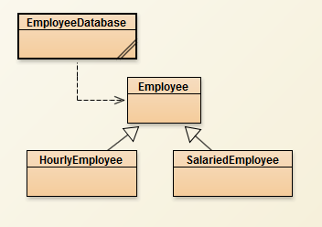
A Simple Class to Demo using abstract classes/ methods
We will build a simple class to hold a list of employees
The class will
add an employee
remove an employee
return a string representation for all current employees
Note:
EmployeeDatabase
only knows about
Employee

Slide 24
EmployeeDatabase
public class EmployeeDatabase
{
private ArrayList<Employee> employees;
public EmployeeDatabase()
{
employees = new ArrayList<Employee>();
}
public void addEmployee(Employee employee)
{
employees.add(employee);
}
More code on next slide

Slide 25
EmployeeDatabase
public void deleteEmployee(Employee employee)
{
employees.remove(employee);
}
public String toString()
{
String theEmployees = "The employees \n";
for( Employee employee : employees)
theEmployees = theEmployees + employee +"\n";
return theEmployees;
}
}
works because toString() is defined in Employee and its subclasses

Slide 26
Exercise 5
Add the class EmployeeDatabase to your project
Test the class by adding and removing a mix of SalariedEmployees and HourlyEmployees

Slide 27
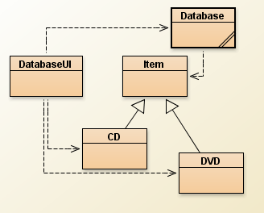
Revisit DOME
Current state:
Problem: the output from getDetails in
the subclasses is not ideal – some data in “wrong” order

Slide 28
Revised DOME
Place all responsibility for producing the details string into each subclass.
But want to ensure that each has a getDetails method.
Would we ever want an Item object?

Slide 29
Exercise 6
Create a new project AbstractDome
Copy the files for dome-v3 into your project
Make Item abstract
Make the getDetails in Item abstract
Modify the getDetails in the subclasses

Slide 30
public abstract class Item
public abstract String getDetails();
CD
public String getDetails()
{
String details = artist + " "
+ getTitle() +"\n";
details = details +"tracks: "
+ numberOfTracks + " ";
details = details + "playing time “
+ getPlayingTime() + " mins \n";
if(getOwn())
details = details + "*" + "\n";
else
details = details + "\n";
details = details + " "
+ getComment() + "\n";
return details;
}
DVD
public String getDetails()
{
String details = director + " "
+ getTitle() + "\n ";
details = details + "playing time : "
+ getPlayingTime() + " mins \n";
if(getOwn())
details = details + "*" + "\n";
else
details = details + "\n";
details = details + " "
+ getComment() + "\n";
return details;
}

Slide 31
Review
Inheritance can provide shared implementation.
Concrete and abstract classes.
Inheritance provides shared type information.
Classes and interfaces.

Slide 32
Review
Abstract classes / methods
Interfaces
Abstract methods allow static type checking without requiring implementation.
Abstract classes function as incomplete superclasses.
No instances.
Abstract classes support polymorphism.
Interfaces provide specification without implementation.
Interfaces are fully abstract.
Interfaces support polymorphism.
Java interfaces support multiple inheritance

